Slide 1
Animal Models of Human Diseases
by
Arta Olya
May 2023
Laboratory of Human Molecular Genetics,
Institute of Molecular Biology and Biotechnology

Slide 2
Objectives
To understand the importance of animal models in studying human diseases.
To learn about the different types of animal models used in biomedical research.
To understand the ethical issues surrounding animal research.
To understand the principles of genetic manipulation of animal models and its applications.
To gain hands-on experience in using computer software to design and analyze animal models.

Slide 3
Outline
Introduction to animal models of human diseases:
This section recapitulates the basics of why animal models are used in biomedical research, the types of animal models, and their limitations.
Genetic manipulation of animal models:
This section covers the principles of genetic manipulation of animal models, including transgenic, knockout, and knock-in models as well as their applications of these models in studying human diseases.
Computer-based tools for animal model design:
This section introduces the participants to different computer-based tools for designing animal models (CRISPR/Cas9).
Hands-on section:
This section allows participants to gain practical experience in designing and analyzing animal models (gene expression) using computer-based tools and databases.

Slide 4
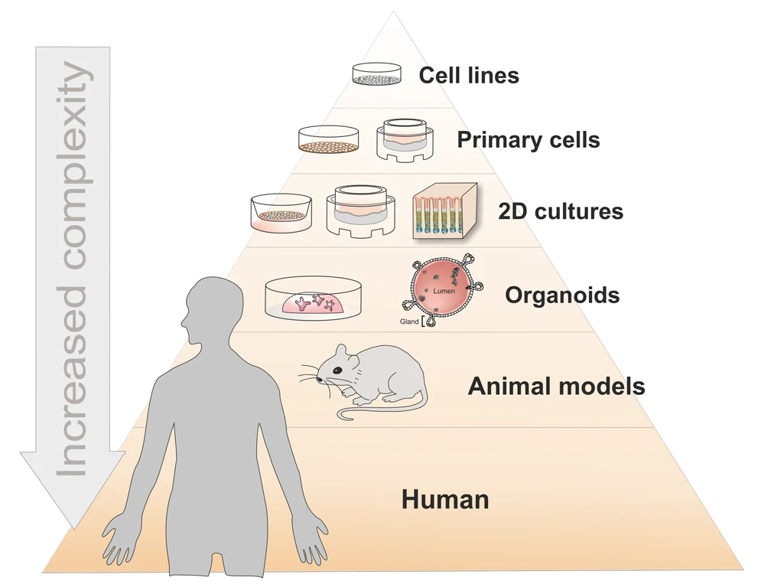
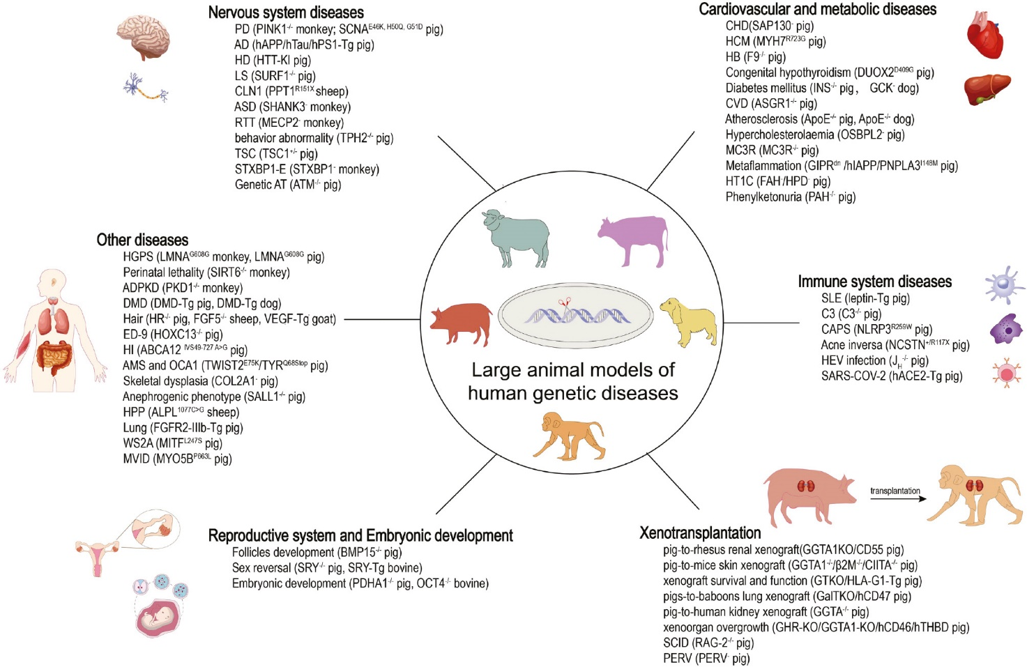
Introduction
The importance of animal models in biomedical research:
To understand the underlying mechanisms of human diseases, to test potential treatments, and to develop new therapies.
1,2

Slide 5
The importance of animal models in biomedical research:
To understand the underlying mechanisms of human diseases, to test potential treatments, and to develop new therapies.
Example: PDX mouse models
(PDX= Patient-Derived Xenograft)
3

Slide 6
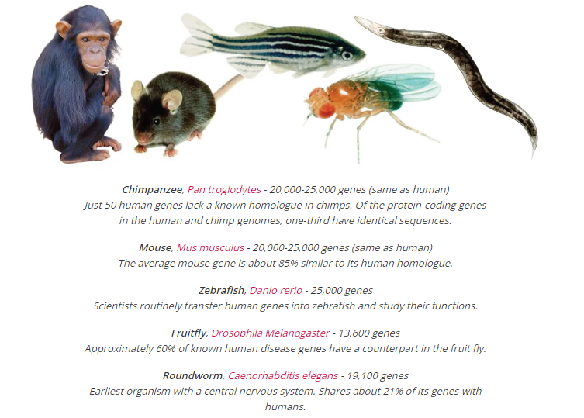
Different types of animal models that are commonly used in biomedical research:
4

Slide 7
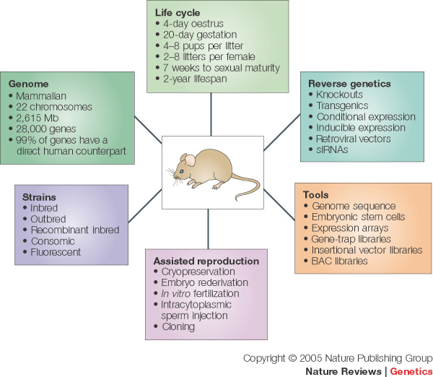
Different types of animal models that are commonly used in biomedical research:
Mice (Mus musculus): the most commonly used.
5

Slide 8
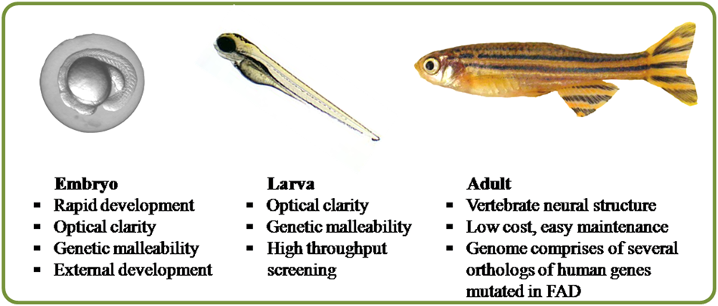
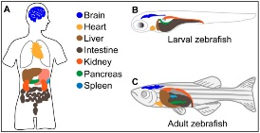
Different types of animal models that are commonly used in biomedical research:
Mice (Mus musculus): the most commonly used.
Zebrafish (Danio rerio): the development of organs and tissues can be visualized in real-time.
6, 7

Slide 9
Different types of animal models that are commonly used in biomedical research:
Mice (Mus musculus): the most commonly used.
Zebrafish (Danio rerio): the development of organs and tissues can be visualized in real-time.
Fruit flies (Drosophila melanogaster): genetic studies; Drug discovery.
Roundworm (Caenorhabditis elegans): developmental biology; Neurobiology; Aging.
Chimpanzee (Pan troglodytes) and other non-human primates: diseases that are unique to humans, such as HIV.
They are expensive to maintain and their use in research raises ethical concerns
Rats: used in research on a variety of diseases, including cancer, cardiovascular disease, and diabetes.
Rabbits: used in research on cardiovascular disease, ophthalmology, and immunology.
Guinea pigs: used in research related to infectious diseases, such as tuberculosis.
And the list goes on…

Slide 10
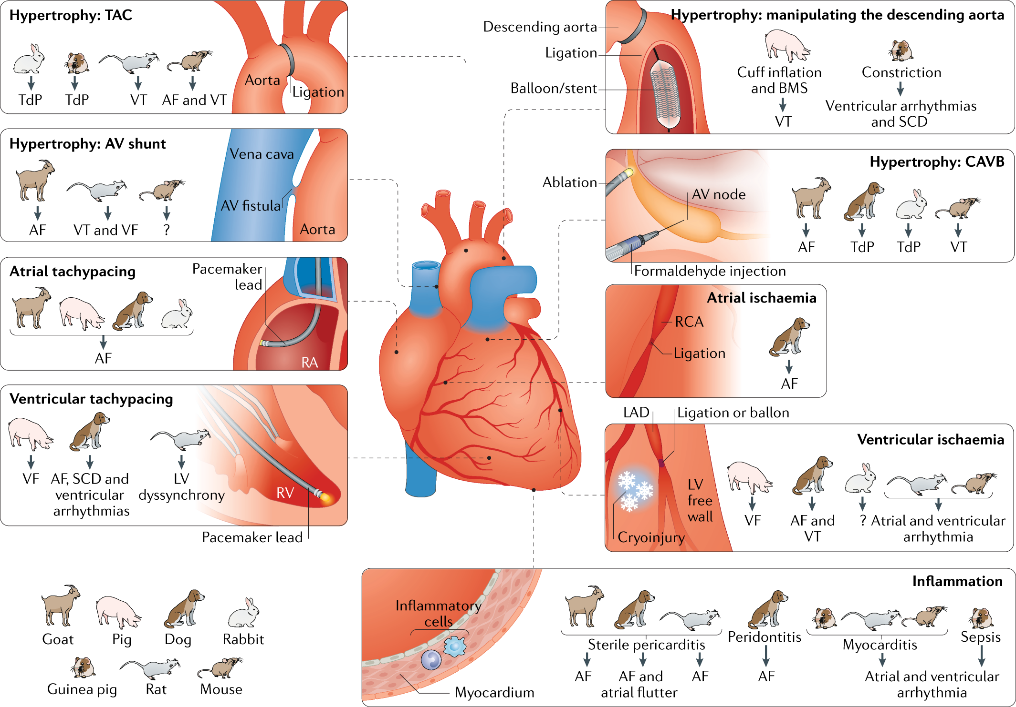
Different types of animal models that are commonly used in biomedical research:
Selecting the appropriate animal model
8

Slide 11
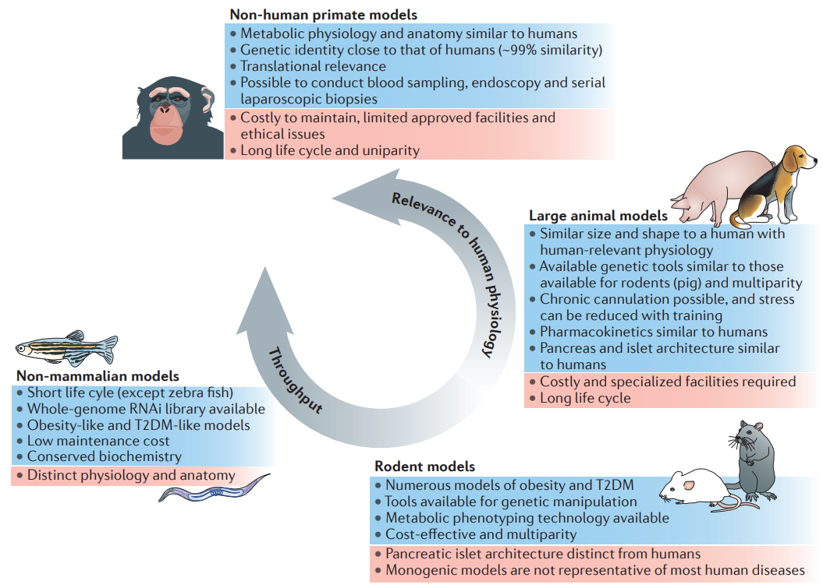
Different types of animal models that are commonly used in biomedical research:
A trade-off between throughput/cost and anatomical/physiological similarity to humans (as well as raising ethical issues)
9

Slide 12
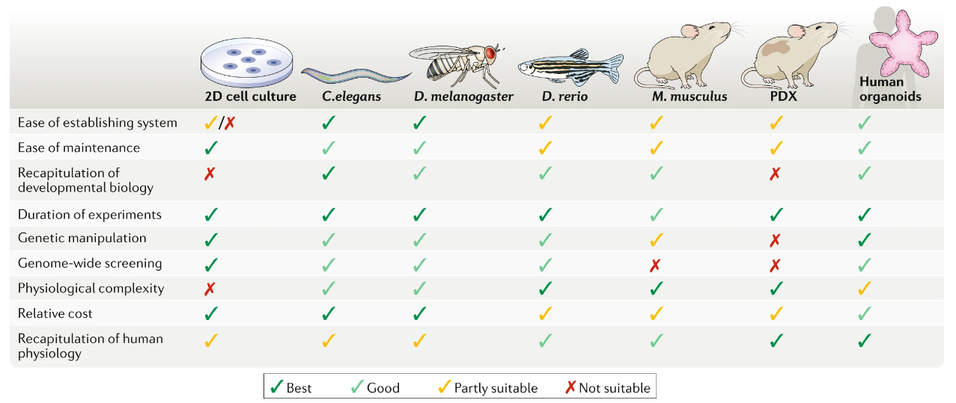
Different types of animal models that are commonly used in biomedical research:
It is important to note that animal models are not perfect replicas of human diseases and may not always accurately predict how a treatment will work in humans. Therefore, it is important to use animal models in conjunction with other approaches, such as in vitro studies and clinical trials, to fully understand and develop treatments for human diseases.
10

Slide 13
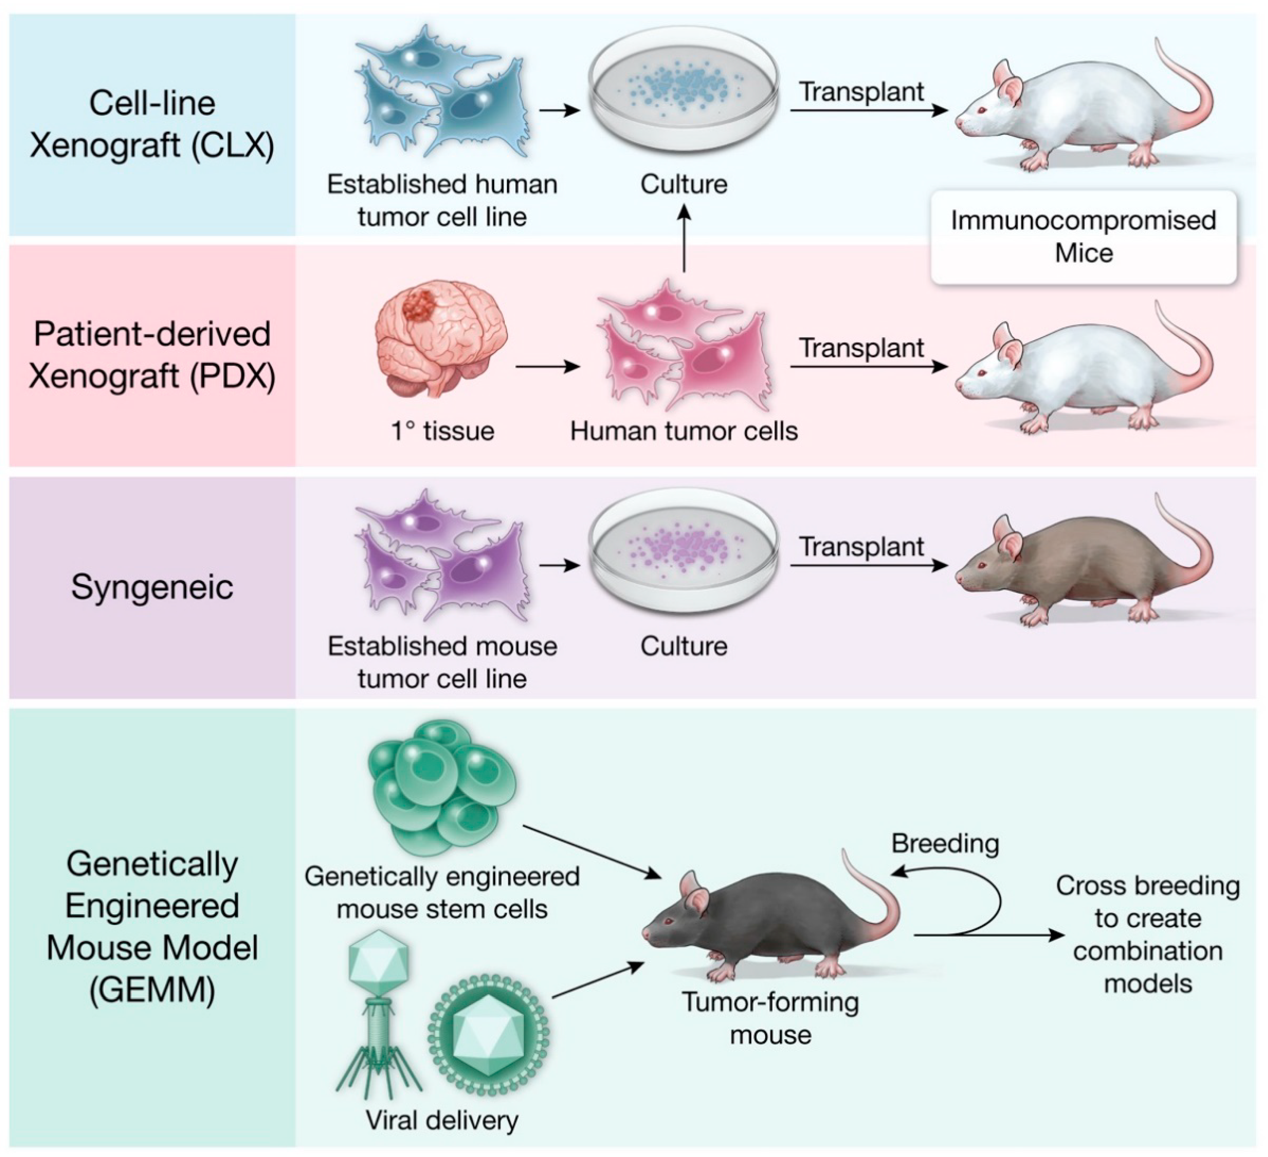
The relevance of animal models to human diseases:
Cancer Research
Genetically Engineered Mouse Models
(GEMMs)
11

Slide 14
Ethics of animal research:
The Three Rs (Replacement, Reduction, and Refinement):
The Three Rs are a set of guiding principles that are used to minimize animal use and suffering in research. Replacement refers to the use of non-animal alternatives whenever possible, reduction refers to the use of the minimum number of animals necessary to achieve the research goals, and refinement refers to the use of techniques and procedures that minimize animal suffering.
Animal Welfare:
This involves providing animals with appropriate housing, food, water, and veterinary care, and minimizing any pain, distress, or suffering that they may experience during research procedures.
Ethical Review:
The responsible committees review research proposals to ensure that they comply with animal welfare regulations.
Reporting and Transparency:
Animal research is subject to reporting and transparency requirements, which insure that the scientific community and the public are aware of the use of animals in research and that research is carried out in an ethical and responsible manner.

Slide 15
Outline
Introduction to animal models of human diseases
Genetic manipulation of animal models
Computer-based tools for animal model design
Hands-on section

Slide 16
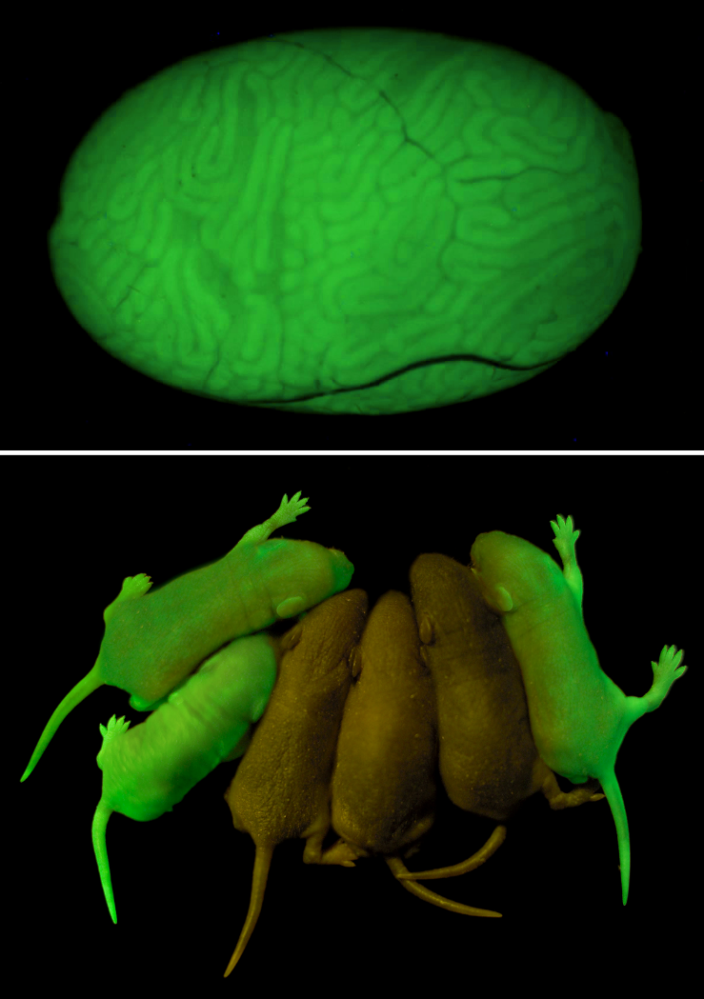
Genetic manipulation of animal models
Genetic manipulation of animal models involves altering their genetic material to create animals with specific traits or characteristics that are relevant to human disease.
1.Transgenic models:
These are animals that have been genetically engineered to carry foreign genes (i.e., genes from another species) that are not normally found in the animal's genome. Transgenic animals are created by introducing foreign DNA into the fertilized egg or early embryo of the animal.
Example: GFP (Green fluorescent protein)
12

Slide 17
Genetic manipulation of animal models
Genetic manipulation of animal models involves altering their genetic material to create animals with specific traits or characteristics that are relevant to human disease.
1.Transgenic models:
These are animals that have been genetically engineered to carry foreign genes (i.e., genes from another species) that are not normally found in the animal's genome. Transgenic animals are created by introducing foreign DNA into the fertilized egg or early embryo of the animal.
2.Knockout models:
These are animals that have been genetically engineered to have one or more genes "knocked out" or deleted from their genome. Knockout animals are created by using gene editing techniques to disrupt or delete a specific gene in the animal's DNA.
3.Knock-in models:
These are animals that have been genetically engineered to have a specific gene added to their genome at a specific location. Knock-in mice can be created to carry specific mutations or genetic variations associated with human diseases.

Slide 18
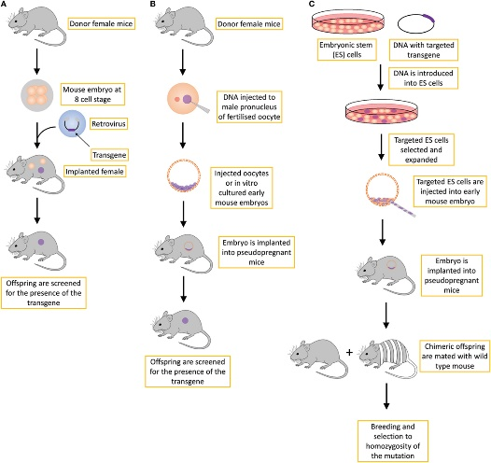
Genetic manipulation of animal models
Different strategies for making transgenic mice:
13

Slide 19
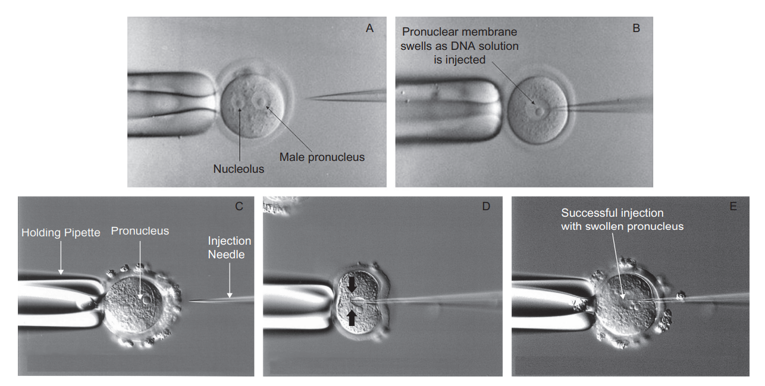
Genetic manipulation of animal models
Microinjection:
14

Slide 20
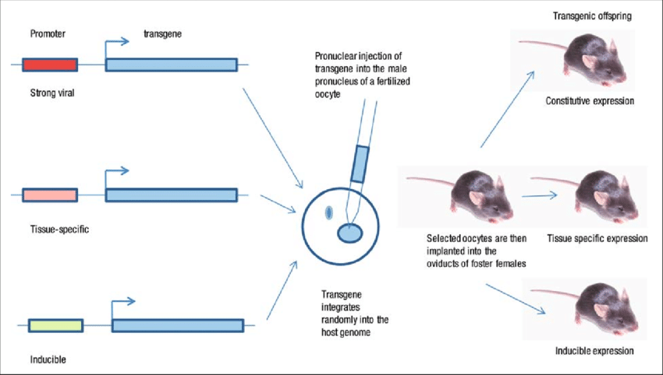
Genetic manipulation of animal models
Conditional (inducible/tissue-specific) expression and knockouts using Cre-Lox system:
15

Slide 21
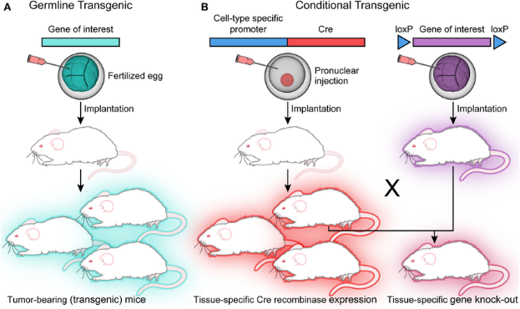
Genetic manipulation of animal models
Conditional (inducible/tissue-specific) expression and knockouts using Cre-Lox system:
Cre (causes recombination)
LoxP (Locus of x(cross)-over, P1)
16

Slide 22
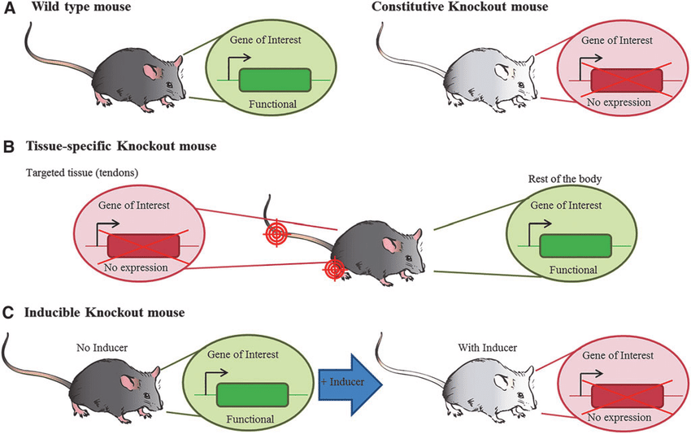
Genetic manipulation of animal models
Conditional (inducible/tissue-specific) expression and knockouts using Cre-Lox system:
17

Slide 23
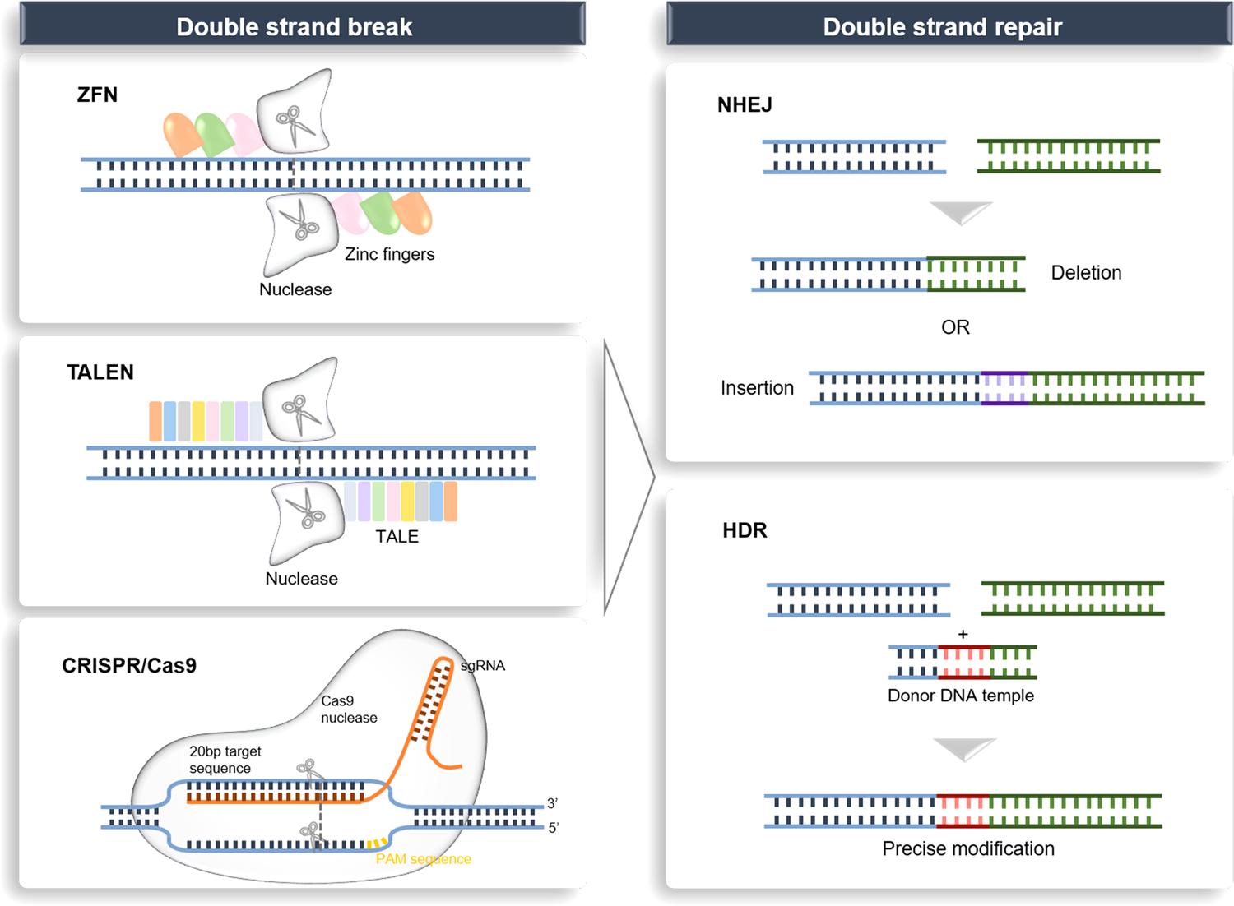
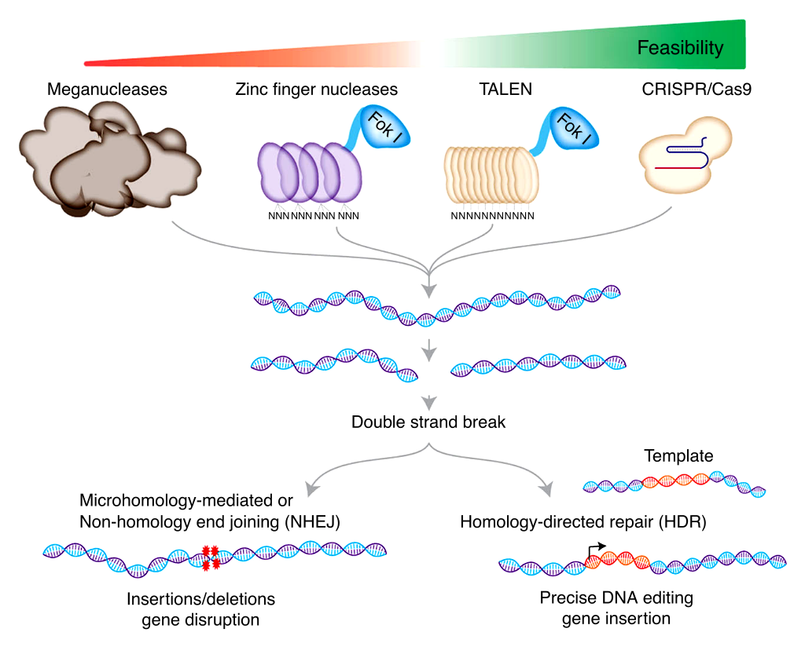
Genetic manipulation of animal models
Genome editing platforms and mechanisms for double-stranded break repair with endogenous DNA
TALEN:
Transcription Activator-Like Effector Nuclease
18, 19

Slide 24
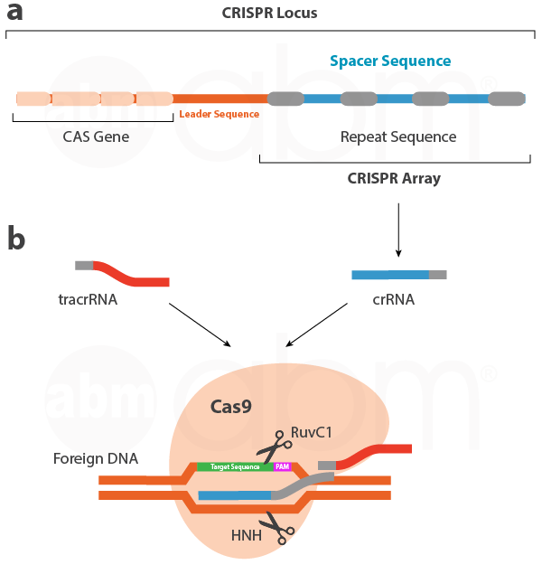
Genetic manipulation of animal models
Clustered Regularly Interspaced Short Palindromic Repeats (CRISPR)
20

Slide 25
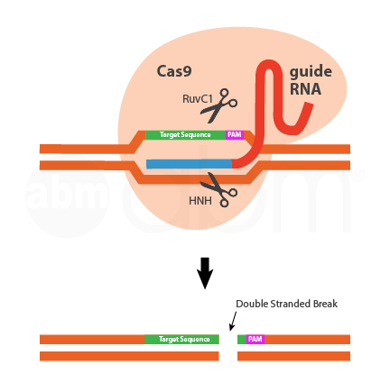
Genetic manipulation of animal models
Clustered Regularly Interspaced Short Palindromic Repeats (CRISPR)
20

Slide 26
Genetic manipulation of animal models
Clustered Regularly Interspaced Short Palindromic Repeats (CRISPR)
Protospacer Adjacent Motif
20

Slide 27
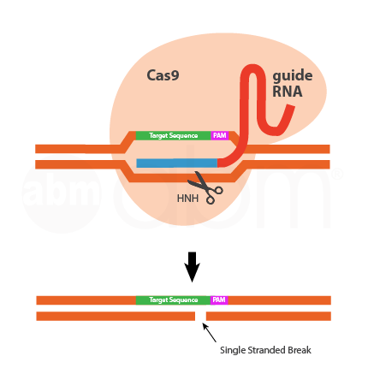
Genetic manipulation of animal models
CRISPR modifications and development
Cas9 Nickase
20

Slide 28
Genetic manipulation of animal models
CRISPR modifications and development
Cas9 Nickase
20

Slide 29
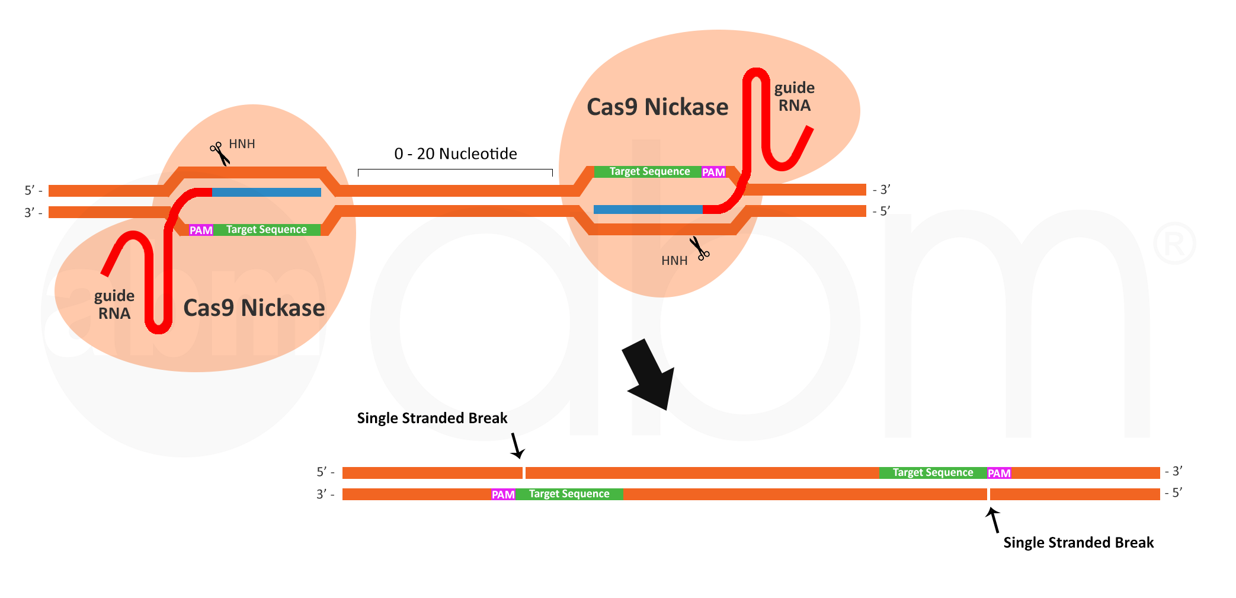
Genetic manipulation of animal models
CRISPR modifications and development
Cas9 Nickase
20

Slide 30
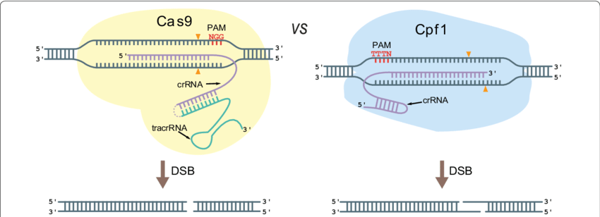
Genetic manipulation of animal models
CRISPR modifications and development
Cas9 vs Cpf1
21

Slide 31
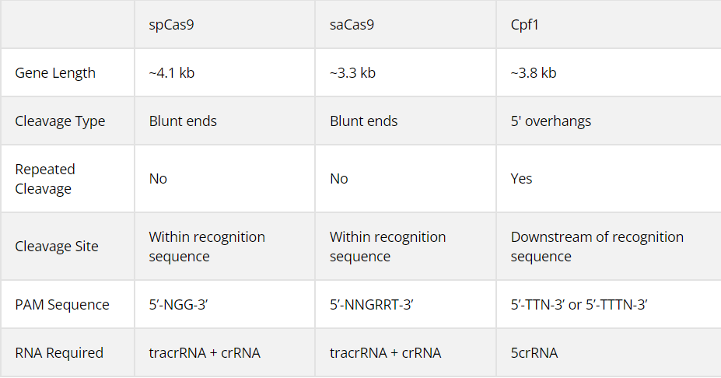
Genetic manipulation of animal models
CRISPR modifications and development
Comparison of spCas9, saCas9, and Cpf1 nucleases
(Streptococcus pyogenes)
(Staphylococcus aureus)
(CRISPR from Prevotella and Francisella 1)

Slide 32
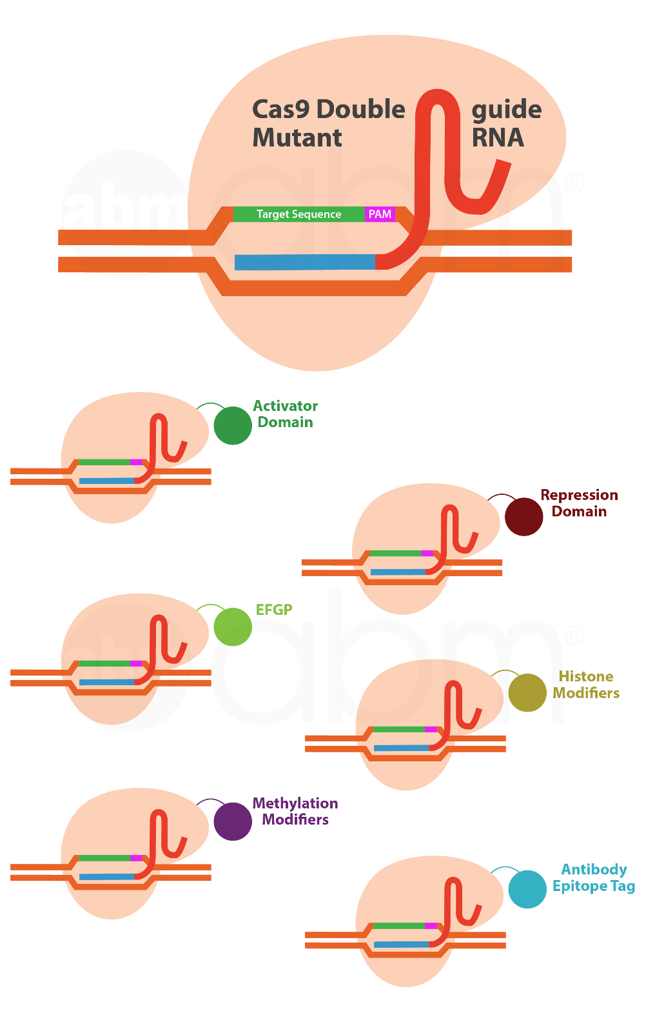
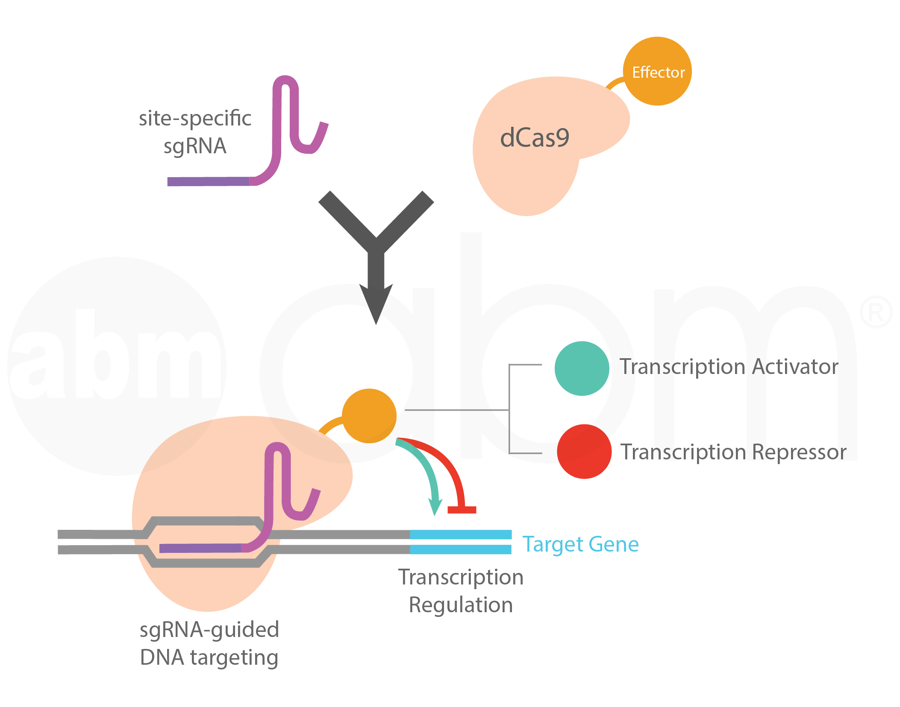
Genetic manipulation of animal models
CRISPR modifications and development
dCas9
dead Cas9 (nuclease deficient / null mutant)
20

Slide 33
Outline
Introduction to animal models of human diseases
Genetic manipulation of animal models
Computer-based tools for animal model design
Hands-on section

Slide 34
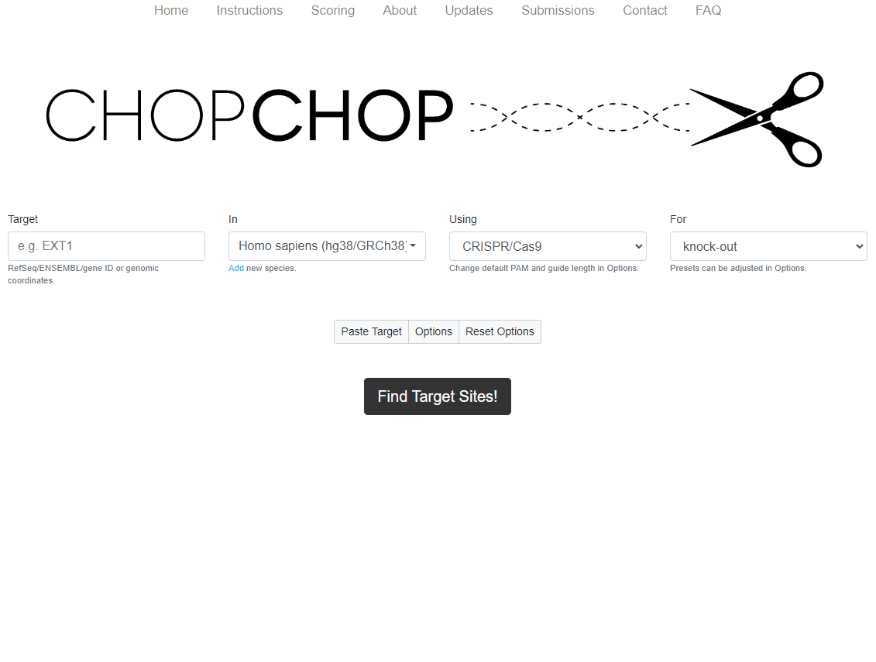
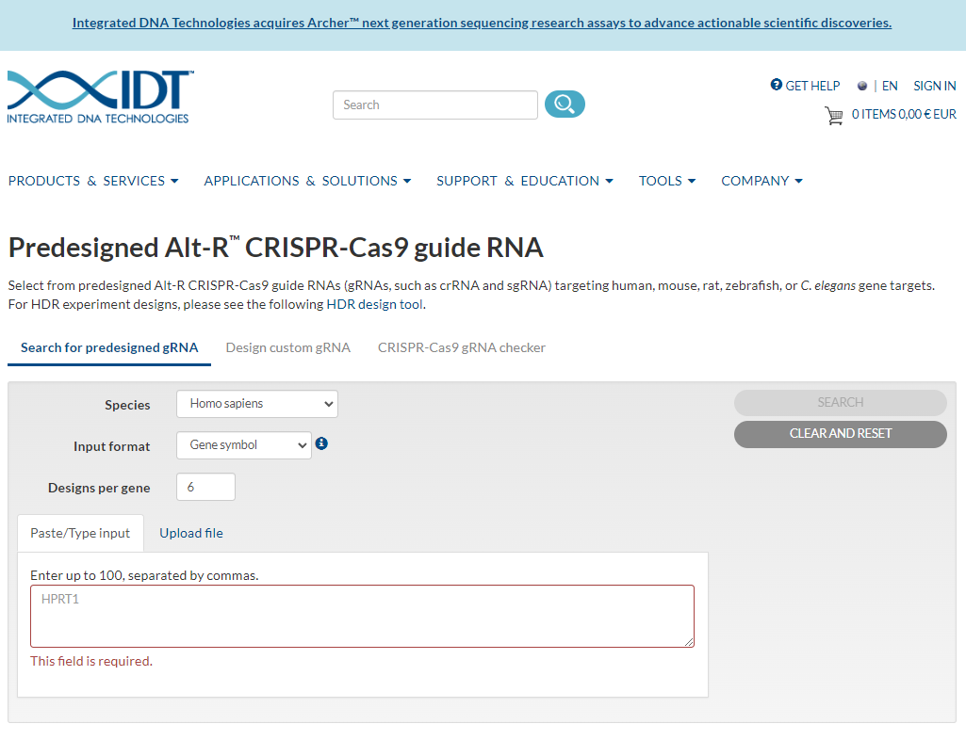
Computer-based tools for animal model design
CRISPR guide RNA (gRNA / sgRNA) design:
CHOP CHOP IDT

Slide 35
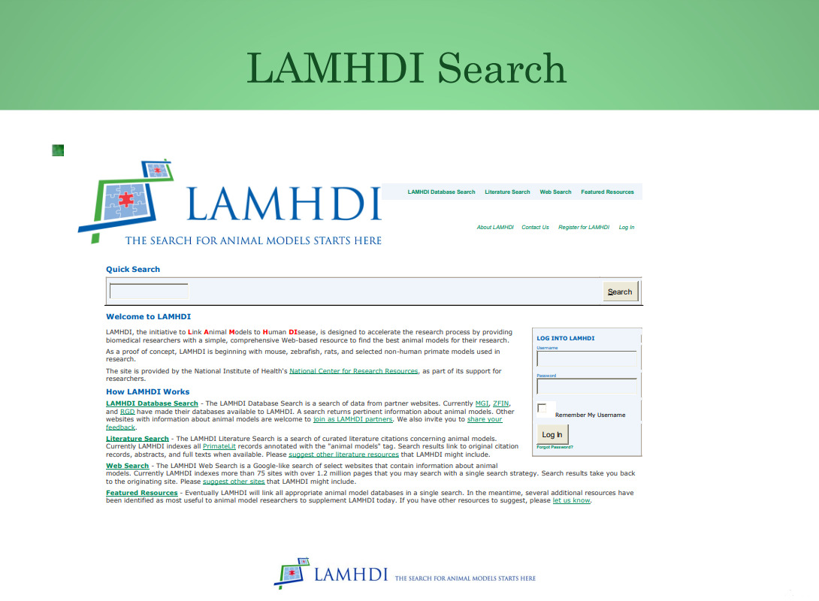
Computer-based tools for animal model design
LAMHDI: The Initiative to Link Animal Models to Human DIsease
LAMHDI

Slide 36
Outline
Introduction to animal models of human diseases
Genetic manipulation of animal models
Computer-based tools for animal model design
Hands-on section

Slide 37
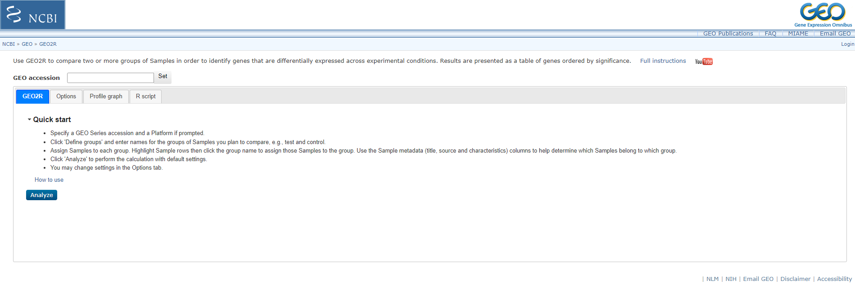
Hands-on section
Gene expression analysis:
GEO2R web-based tool

Slide 38
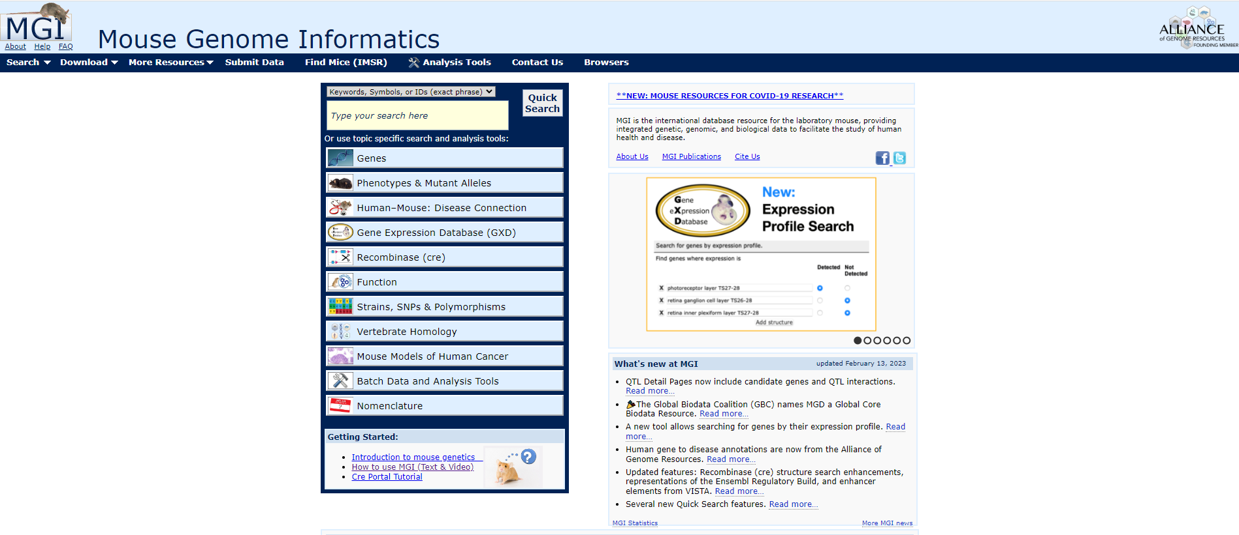
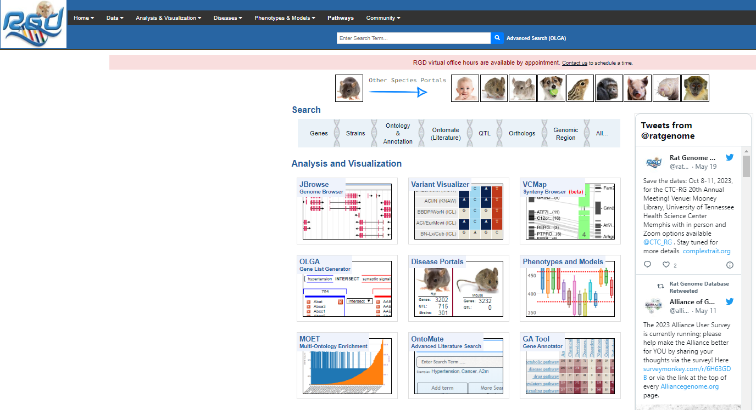
Hands-on section
The following databases provide comprehensive resources and information on various aspects of mouse and rat genetics, genomics, and phenotypes:
MGI (Mouse Genome Informatics) RGD (Rat Genome Database)

Slide 39
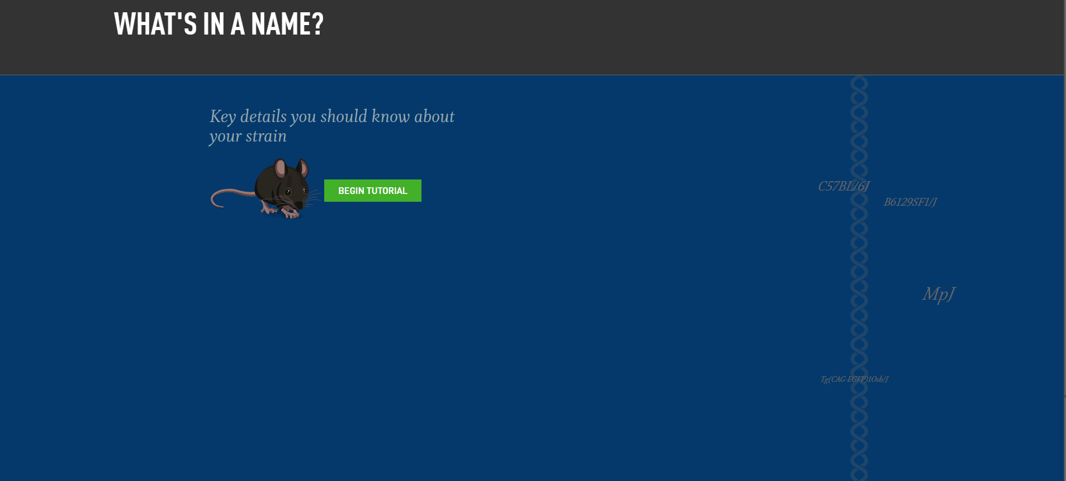
Hands-on section
An interactive tutorial to learn the mouse gene & strain nomenclature

Slide 40
Presentation
Please prepare a 10-minute PowerPoint presentation for the next session (maximum 15 minutes) in which you explain the process of selecting and creating a hypothetical animal model for a specific disease of your choice. If you prefer to make a poster instead, please feel free to do so.
Please insure that your presentation incorporates the following structure: introduction, methodology, discussion of potential outcomes, and risk assessment.
This presentation file is available on DHMG & LHTT website.
You are more than welcome to contact me via Teams or e-mail (arta.olya@amu.edu.pl) in case you have any questions or need help.
Good luck! ☺

Slide 41
Thank you very much for your attention!
See you next week! ☺

Slide 42
References
1- Aguilar, C., Alves da Silva, M., Saraiva, M., Neyazi, M., Olsson, I. A., & Bartfeld, S. (2021). Organoids as host models for infection biology – a review of methods. Experimental & Molecular Medicine, 53(10), 1471-1482. https://doi.org/10.1038/s12276-021-00629-4
2- Zhang, J., Sun, X., & Cao, C. (2022). Recent advances in genetically modified large-animal models of human diseases. BIO Integration, 3(4), 161-171. https://doi.org/10.15212/bioi-2022-0018
3- Choi, Y., Lee, S., Kim, K., Kim, S., Chung, Y., & Lee, C. (2018). Studying cancer immunotherapy using patient-derived xenografts (PDXs) in humanized mice. Experimental & Molecular Medicine, 50(8), 1-9. https://doi.org/10.1038/s12276-018-0115-0
4- Mouse party. (n.d.). Learn.Genetics. https://learn.genetics.utah.edu/content/addiction/mouse/
5- Mice as models for human genetics. (n.d.). Nature. https://www.nature.com/scitable/content/mice-as-models-for-human-genetics-4771/
6- Saleem, S., & Kannan, R. R. (2018). Zebrafish: An emerging real-time model system to study Alzheimer’s disease and neurospecific drug discovery. Cell Death Discovery, 4(1). https://doi.org/10.1038/s41420-018-0109-7
7- Wang, X., Copmans, D., & De Witte, P. A. (2021). Using Zebrafish as a disease model to study fibrotic disease. International Journal of Molecular Sciences, 22(12), 6404. https://doi.org/10.3390/ijms22126404
8- Clauss, S., Bleyer, C., Schüttler, D., Tomsits, P., Renner, S., Klymiuk, N., Wakili, R., Massberg, S., Wolf, E., & Kääb, S. (2019). Animal models of arrhythmia: Classic electrophysiology to genetically modified large animals. Nature Reviews Cardiology, 16(8), 457-475. https://doi.org/10.1038/s41569-019-0179-0
9- Animal models of obesity and diabetes mellitus. (2018, January 19). Nature. https://www.nature.com/articles/nrendo.2017.161
10- Kim, J., Koo, B., & Knoblich, J. A. (2020). Human organoids: Model systems for human biology and medicine. Nature Reviews Molecular Cell Biology, 21(10), 571-584. https://doi.org/10.1038/s41580-020-0259-3
11- Hicks, W. H., Bird, C. E., Traylor, J. I., Shi, D. D., El Ahmadieh, T. Y., Richardson, T. E., McBrayer, S. K., & Abdullah, K. G. (2021). Contemporary mouse models in glioma research. Cells, 10(3), 712. https://doi.org/10.3390/cells10030712

Slide 43
References
12- GFPPupsAndTestisForWiki [ Top panel. Recipient mouse testis that was injected with genetically modified spermatogonial stem cells containing a reporter transgene for Green Fluorescent Protein (GFP), which will fluoresce green. Bottom Panel. The testis will produce spermatozoa that transmitted the GFP transgene to offspring.]. (2021, December 29). Wikimedia.org/. https://commons.wikimedia.org/wiki/File:GFPPupsAndTestisForWiki.jpg
13- Transgenic mouse models in cancer research. (n.d.). Frontiers. https://www.frontiersin.org/articles/10.3389/fonc.2018.00268/full
14- White, K. E., Koller, D. L., & Corbin, T. (2014). Skeletal genetics. Basic and Applied Bone Biology, 149–171. https://www.sciencedirect.com/science/article/pii/B9780124160156000083?via%3Dihub
15- Santos, J., Fernández-Navarro, P., Villa-Morales, M., González-Sánchez, L., & Fernández-Piqueras, J. (2008). Genetically modified mouse models in cancer studies. Clinical and Translational Oncology, 10(12), 794-803. https://doi.org/10.1007/s12094-008-0292-8
16- Kohnken, R., Porcu, P., & Mishra, A. (2017). Overview of the use of murine models in leukemia and lymphoma research. Frontiers in Oncology, 7. https://doi.org/10.3389/fonc.2017.00022
17- Delgado Caceres, M., Pfeifer, C. G., & Docheva, D. (2018). Understanding tendons: Lessons from transgenic mouse models. Stem Cells and Development, 27(17), 1161-1174. https://doi.org/10.1089/scd.2018.0121
18- Adli, M. (2018). The CRISPR tool kit for genome editing and beyond. Nature Communications, 9(1). https://doi.org/10.1038/s41467-018-04252-2
19- Li, H., Yang, Y., Hong, W., Huang, M., Wu, M., & Zhao, X. (2020). Applications of genome editing technology in the targeted therapy of human diseases: Mechanisms, advances and prospects. Signal Transduction and Targeted Therapy, 5(1). https://doi.org/10.1038/s41392-019-0089-y
20- https://info.abmgood.com/crispr-cas9
21- Vanegas, K. G., Jarczynska, Z. D., Strucko, T., & Mortensen, U. H. (2019). Cpf1 enables fast and efficient genome editing in Aspergilli. Fungal Biology and Biotechnology, 6(1). https://doi.org/10.1186/s40694-019-0069-6

